Slide 1
Recommender System for Movies
INFO411 | FT - Group2

Slide 2
Contribution
Name | UOW ID | Contribution
Joan Wei Qi Tong | 7063325 | 100%
Yeonsu Kim | 6858235 | 100%
Nicole Santiago | 6958333 | 100%
Hongyu Lu | 6858338 | 100%
Phang Zi Kai | 6649312 | 100%
Heng Li En Shaun | 6858144 | 100%

Slide 3
CONTENT
Introduction
Methods
Results
Discussion
Conclusion

Slide 4
INTRODUCTION

Slide 5
Movielens helps movie enthusiasts to find movie of their preference.
Recommendation systems are designed to recommend certain items to its customers. These recommendations are then created on the basis of statistics base on the customer’s profile history and their interests similarities.

Slide 6
GOAL
To develop a recommendation system / prediction model which is capable of predicting the rating of a movie by any given user.

Slide 7
GENERAL DESCRIPTION OF DATASET IN RATINGS
Variables: userId ,movieId ,rating ,timestamp
MovieLens users were selected at random for inclusion. Their ids have been anonymized.
MovieId are consistent with between ratings, tags ,movies and links.
MovieId refers to the same movies across these four data files.
Ratings are made on a 5-star scale, with half-star increments (0.5 stars - 5.0 stars).
Timestamps represent seconds since midnight Coordinated Universal Time (UTC) of January 1, 1970.

Slide 8
GENERAL DESCRIPTION OF DATASET IN MOVIES
Variables (movieId, title, genres)
MovieId are consistent with between ratings, tags ,movies and links.
MovieId refers to the same movies across these four data files.
Title are entered manually and imported from https://www.themoviedb.org/.
Genres list separated by pipeline | includes the following : Action, Adventure, Animation, Children’s, Comedy, Crime, Documentary, Drama, Fantasy, Film-Noir, Horror, Musical, Mystery, Romance, Sci-Fi, Thriller, War , Western.

Slide 9
METHODS

Slide 10
LINEAR REGRESSION WITH REGULARISATION
Linear Regression is the process of fitting a line to the data using the least squares.
We will calculate the 𝑅² and also the prediction value for 𝑅².
This method calculates the best fitting line for the observed data by minimizing the sum of the squares of the vertical deviations from each data point to the line (if a point lies on the fitted line exactly, then its vertical deviation is 0). Because the deviations are first squared, then summed, there are no cancellations between positive and negative values.
In our project, we initially used the values user_score, movie_score, year and week.
Our initial RMSE score is 1.055647

Slide 11
LINEAR REGRESSION
Strengths | Limitations
Efficient with lower time complexity when computing compared to other machine learning algorithms. | Sensitive to outliers. Outliers will have a big impact on performance and must be dealt with appropriately before applying on dataset.
Linear regression fits linearly separable datasets almost perfectly and is often used to find the nature of the relationship between variables. | Linear regression assumes data is independent hence any multicollinear must be removed before applying linear regression
Overfitting can easily be reduced by regularization. | It tends to underfit the data

Slide 12
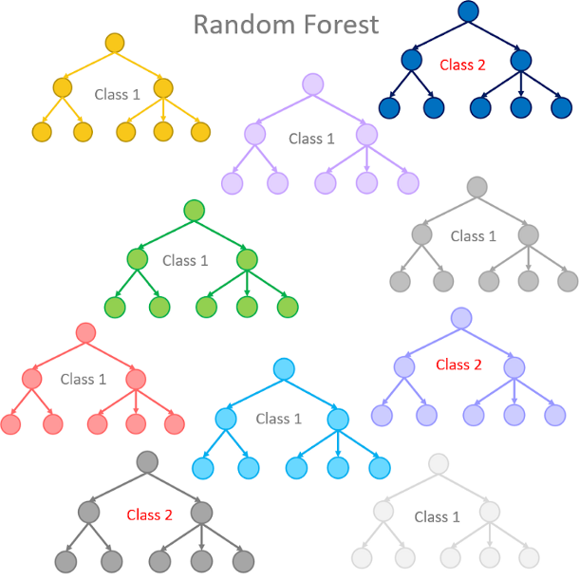
RANDOM FOREST
Random forest is a supervised learning algorithm
It consists of a large number of individual decision trees that operates together.
Each individual tree in the random forest spits out a class prediction and the class with the most votes becomes our model’s prediction.

Slide 13
RANDOM FOREST
Strengths | Limitations
Good for training small dataset | Large number of trees can make the algorithm too slow and ineffective.
It has methods for balancing errors in data sets where classes are imbalanced. | It requires much computational power as well as resources as it builds numerous trees to combine their outputs.
It uses bagging algorithm where it creates as many trees on the subset of the data and combines the output of all the trees. | It requires much time for training as it combines a lot of decision trees to determine the class

Slide 14
SUPPORT VECTOR MACHINES (SVM)
A support vector machine is a supervised machine model that uses classification algorithms to group data into individual categories.
It does this by moving certain data to given points where they can be separated by a line(hyperplane) in visualisation. With more data coming in, more hyperplanes are set to differentiate between the classes.
The support vectors are the points that determine the individual classes and thus set the hyperplane we need to identify future incoming data.

Slide 15
SUPPORT VECTOR MACHINES (SVM)
Strengths | Limitations
Uses a small part of the dataset to achieve support vectors performance | Bigger datasets such as this case will take much longer training time
SVM can work on non-linear datasets | High amounts of noise can cause a worse performance from the model
SVM models have generalization in practice, the risk of over-fitting is less in SVM | In cases where the number of features of reach data point exceeds the number of training data samples, the SVM will underperform.

Slide 16
RESULTS

Slide 17
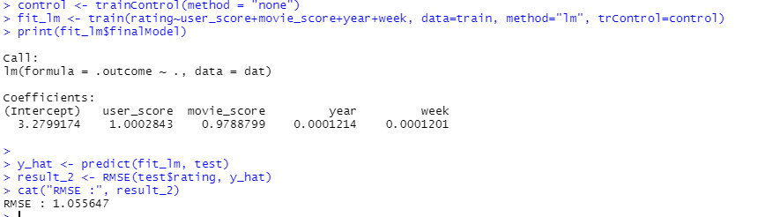
LINEAR REGRESSION RESULTS BASE MODEL
Result RMSE is 1.055 which is unacceptable. Prediction is off by 1. This however does not include the one-hot-encoded genres.

Slide 18
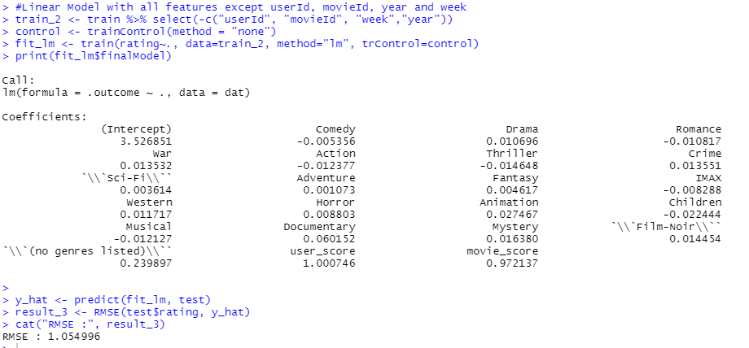
LINEAR REGRESSION RESULTS BASE MODEL
userId, movieId , year and week is removed from the features as its deemed as irrelevant.
Shows insignificant improvement by 0.001.

Slide 19
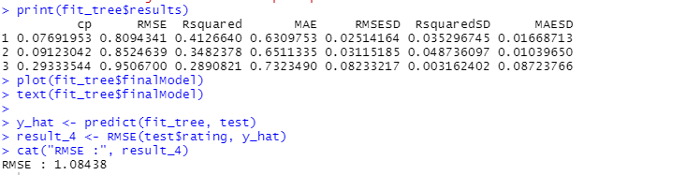
LINEAR REGRESSION RESULTS (CARET)
Using the caret library, we got a result of RMSE 1.084. This more worse than the baseline model.

Slide 20
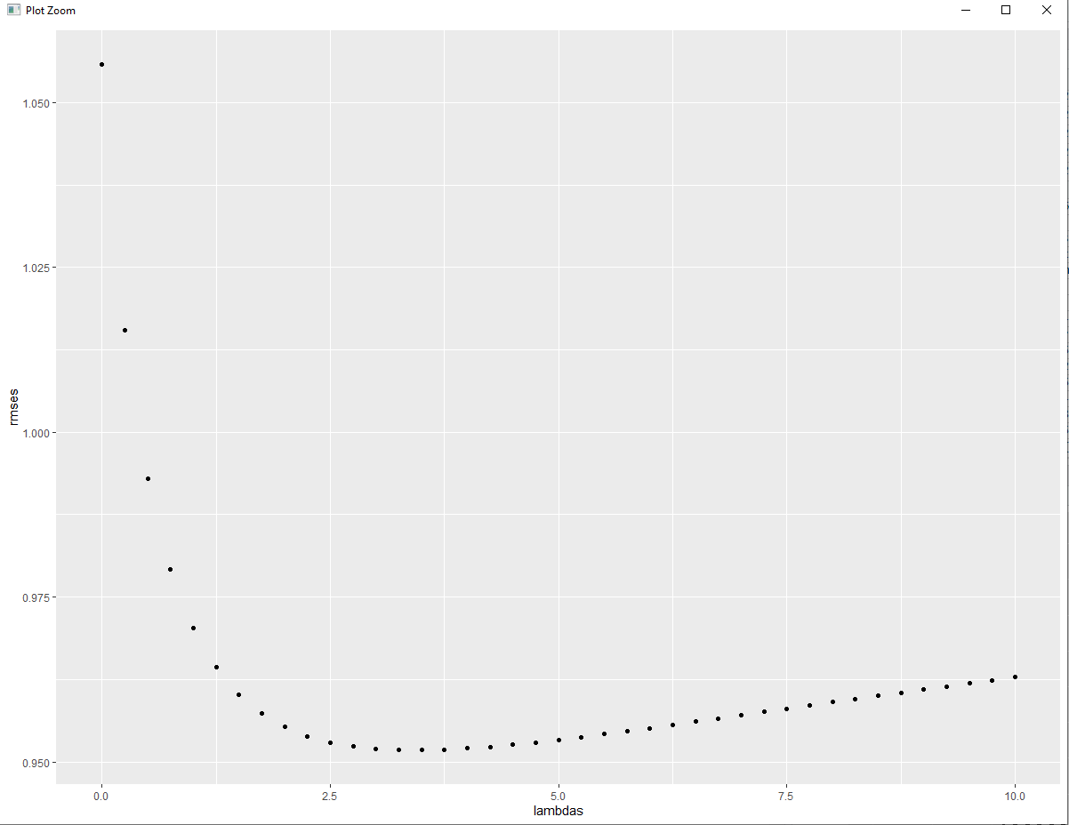
LINEAR REGRESSION WITH REGULARIZATION
We include a lambda parameter in the cost function to prevent overfitting. This lambda is then used to update the theta parameters in the gradient descent algorithm. We can see from the plot that the lambda which minimizes the RMSE is 3.5.

Slide 21
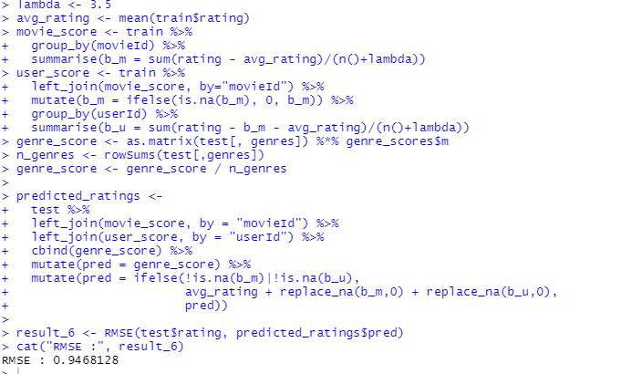
LINEAR REGRESSION RESULT WITH REGULARIZATION
We will use lambda 3.5 to train and predict the test set. The final RMSE score is 0.9468128. This seems to be the lowest but however it is still not optimal. We will move on to other models.

Slide 22
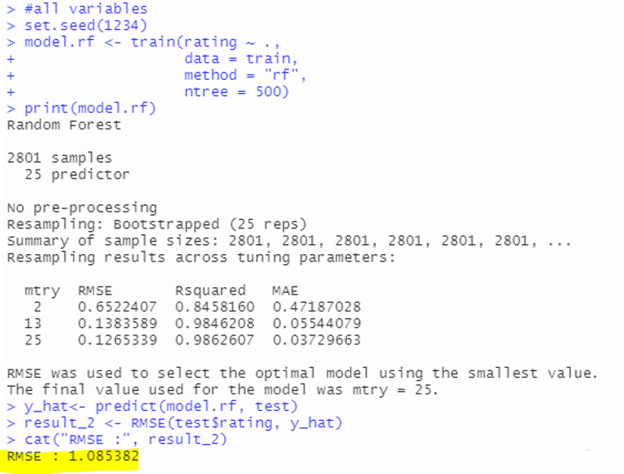
RANDOM FOREST

Slide 23
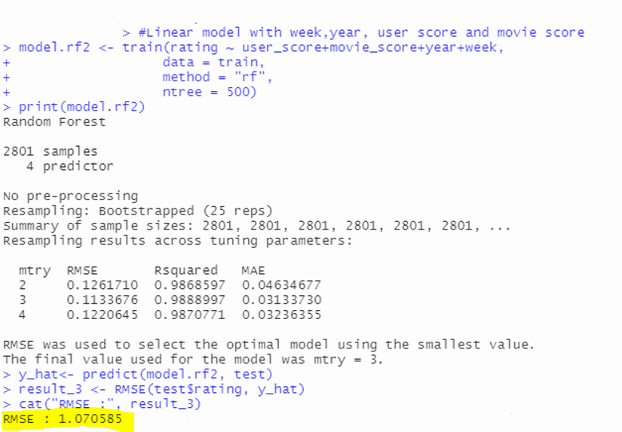
RANDOM FOREST

Slide 24
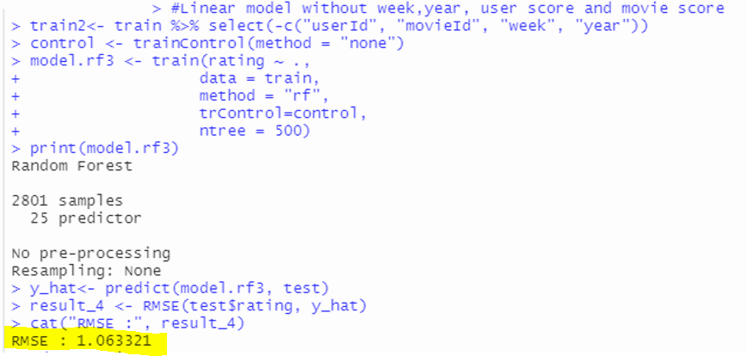
RANDOM FOREST

Slide 25
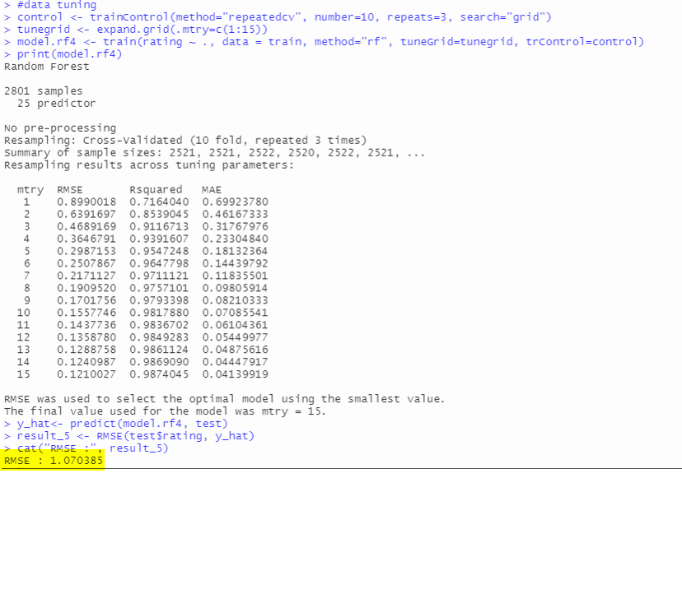
RANDOM FOREST

Slide 26

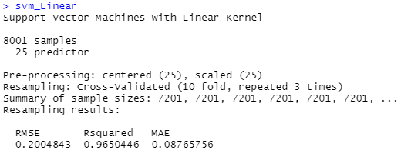
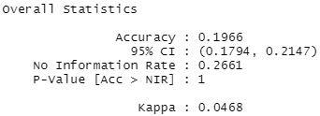

SUPPORT VECTOR MACHINES (SVM)

Slide 27
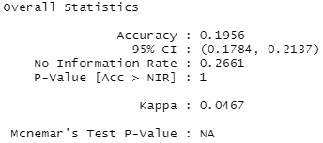

SUPPORT VECTOR MACHINES (SVM)

Slide 28
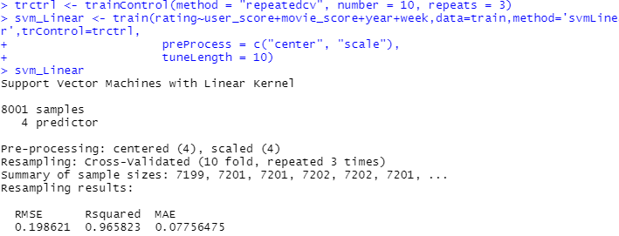

SUPPORT VECTOR MACHINES (SVM)

Slide 29


SUPPORT VECTOR MACHINES (SVM)
Using 20000 data instead of 10000:

Slide 30
Conclusion

Slide 31
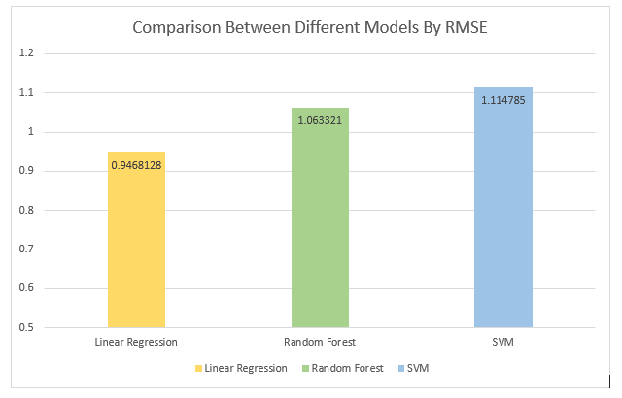

Slide 32
RMSE SCORE EVALUATION FOR LINEAR REGRESSION
The final RMSE score for Linear Regression after tuning is 0.9468128. There is a lot of room for improvement, but we have not found a better solution yet. One idea is to stratify the user_scores by genres, since the same user may love some genres but hate others.I believe that logistic regression will be better for categorical data than linear regression. Linear regression deals with continuous values whereas classification problems mandate discrete values. It is more sensitive to the shift in threshold value when new data points are added.

Slide 33
RMSE SCORE EVALUATION FOR RANDOM FOREST
The final RMSE score for Random Forest is 1.063321.
Can consider running Lasso(Least Absolute Shrinkage and Selection Operator) before Random Forest for a better prediction.
Random Forest may not efficiently incorporate known relationships between the response and the predictors.
It is also unable to discover trends that would enable it in extrapolation values that fall outside of the training set as the same user might not give as high of a rating to a movie genre in the future.
Able to deal with extrapolation by using linear models such as SVM or Linear Regression.

Slide 34
RMSE SCORE EVALUATION FOR SVM
The final RMSE score for SVM is 1.114785. We can see that the results obtained were the worst. However it seems likely that overfitting is the main cause of this issue. More tests or experiments need to be conducted for a better estimation of the models’ performance. Also of note that ratings cluster around a certain score as expected of normal ratings, meaning that the model is unable to set definitive classes as it might look at it as one single class, or have many different classes and thus having trouble relating them to one another.

Slide 35
Q & A

Slide 36
Thank You For Your Kind Attention!

